Slide 1
Super_I_Sense
Image recognition Specially for Visually Impaired people.
Diversity and Inclusion

Slide 2
MISSION
Our aim is to create an interface which ultimately helps the visually impaired by detecting the objects and scenery in the image and assists them using voice.

Slide 3
PROBLEM VS SOLUTION
PROBLEM
SOLUTION
Talkback feature in mobile phone tells the image's file name alone and doesn't explain the contents in the image.
Our interface describes almost every objects and scenery present in the image.

Slide 4
NOVELTY
The already known TALKBACK feature in today’s gadgets can only voice out the actions done by the users.
For EXAMPLE ;
If an image opens , the talkback feature only speaks out the Filename and not the description of the image.
Here comes our Super_I_Sense , which can be Collaborated With the Talkback Feature.Hence it will be made available to everyone in the market.

Slide 5
WORKFLOW:
01
02
03
04
05
OBJECT DETECTION
SCENERY DETECTION
KEYWORD EXTRACTION
It detects object in the image.This is done by using YOLO.
Scenery and the background will be detected
Keywords are extracted by filtering the maximum probable data
SENTENCE FORMATION
AUDIO OUTPUT
With the help of the generated keywords,the most appropriate sentence will be formed
Finally these sentences will be converted to audio as output

Slide 6
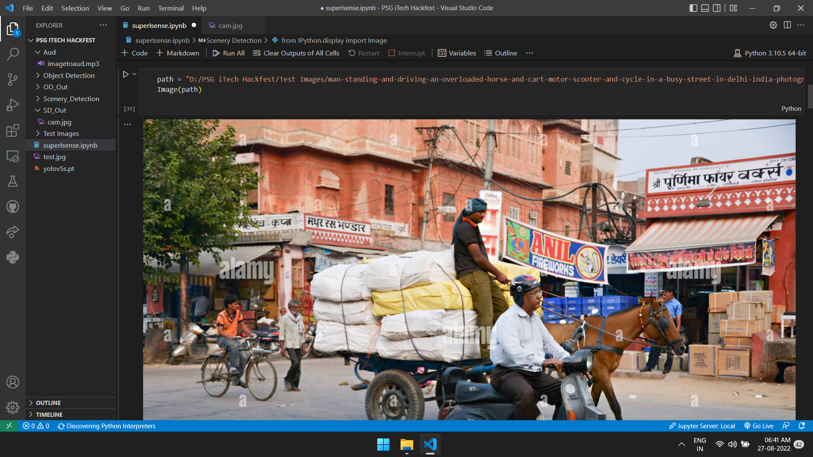

Slide 7
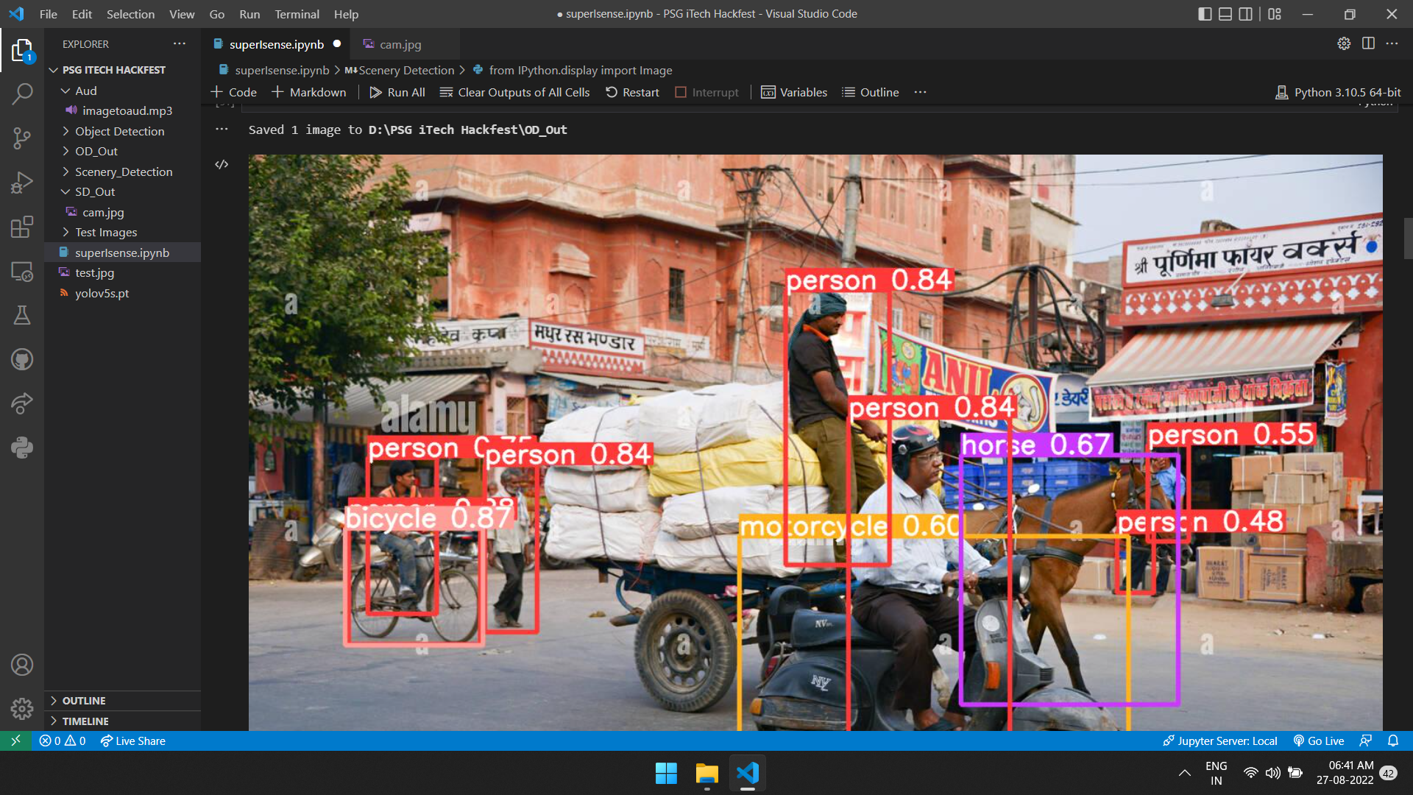

Slide 8
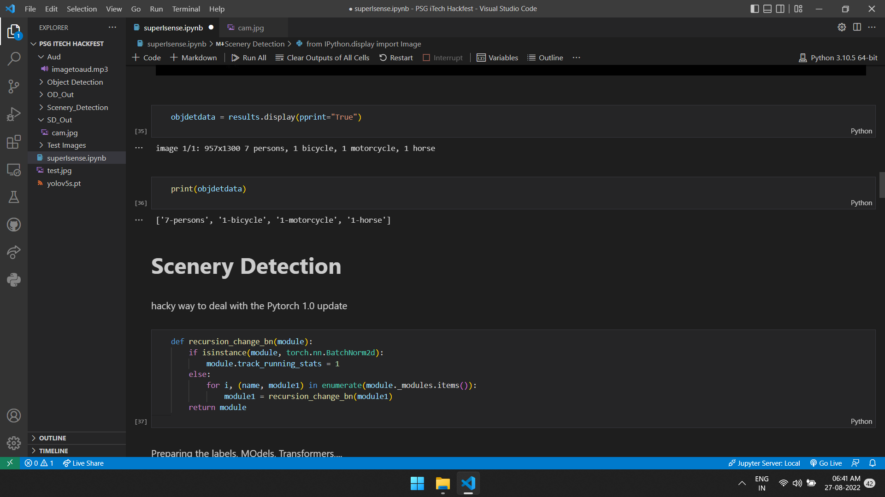

Slide 9
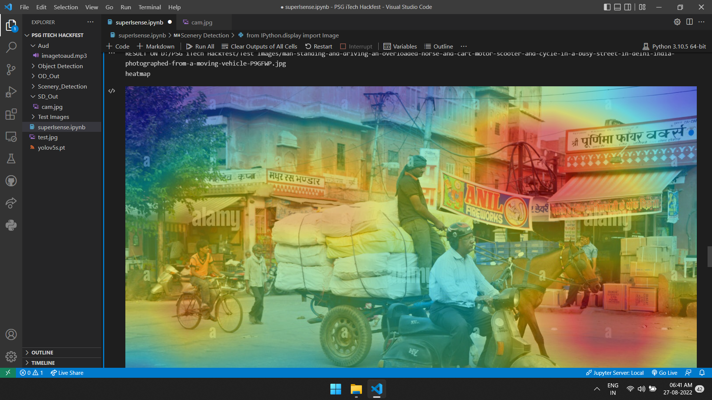

Slide 10
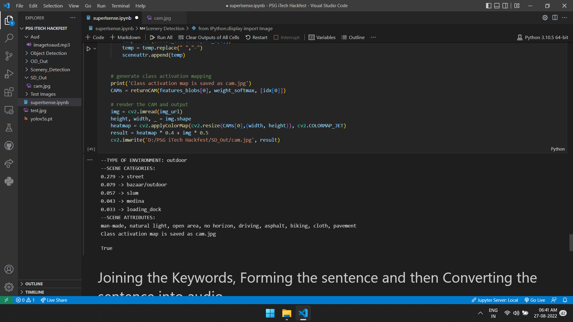

Slide 11
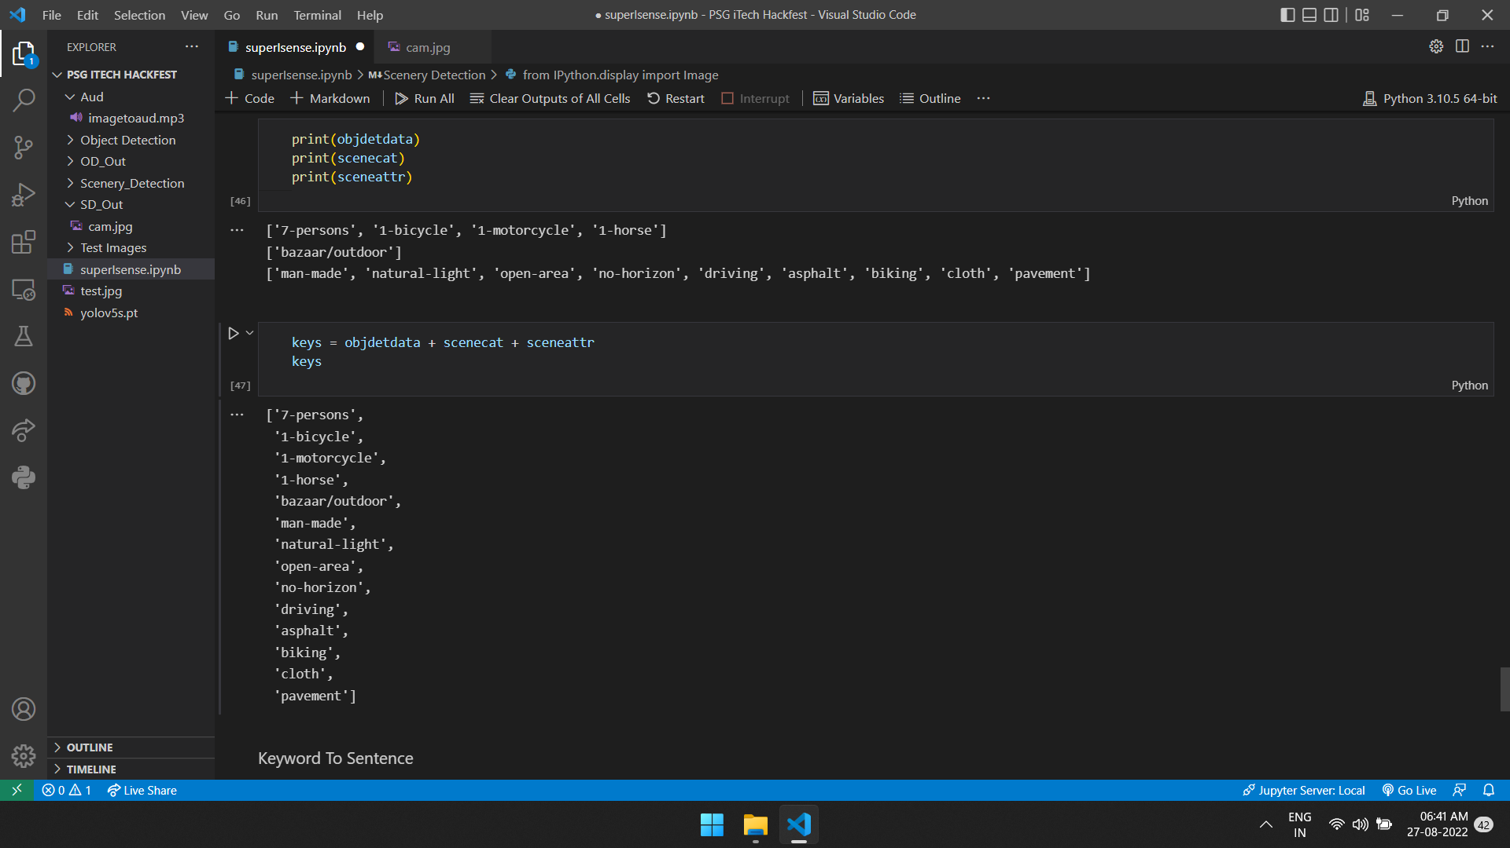

Slide 12
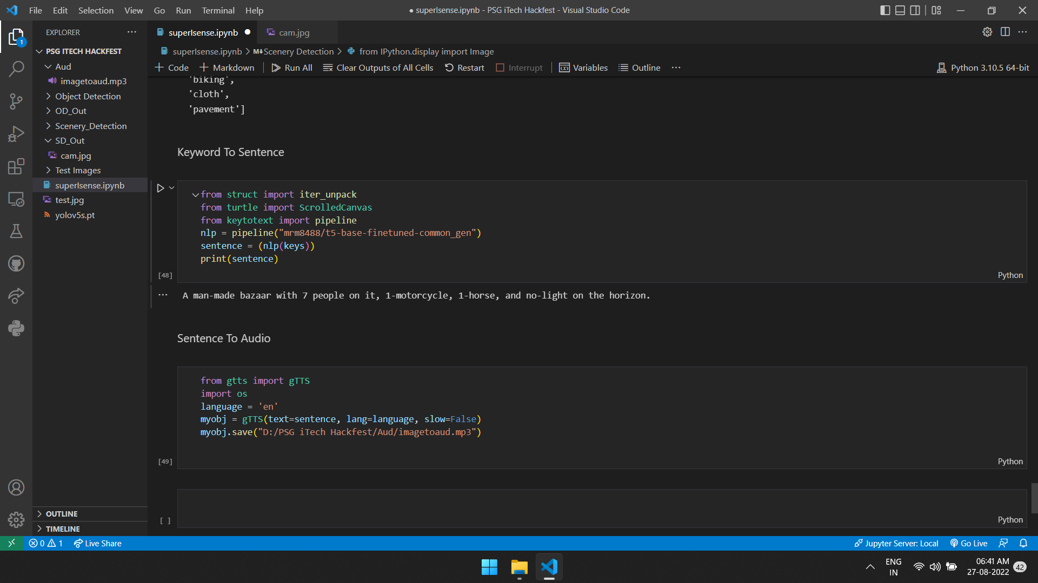

Slide 13
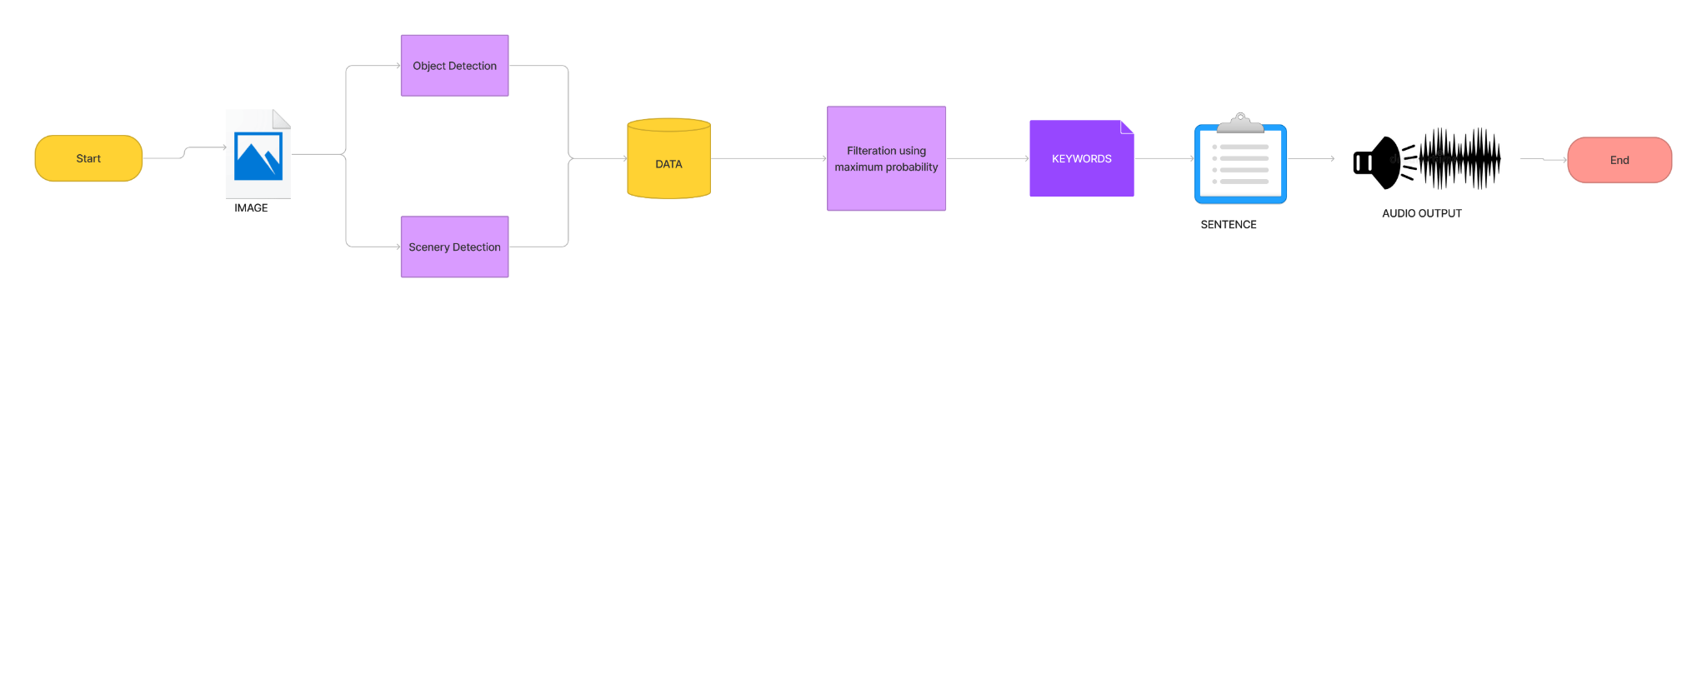

Slide 14



TARGET AUDIENCE
NIGHT BLINDS
PARTIALLY BLINDS
COMPLETELY BLINDS

Slide 15
MARKETING ANALYSIS
We have made a try to upgrade the talk back.After developing this into a full-fledged feature , PATENT RIGHTS can be acquired .
After integrating superisense with the existing talk back , this will become an inbuilt feature in all the upcoming gadgets in the market .So we can make a SURPLUS PROFIT.

Slide 16
CONCLUSION
When a visually impaired person gets access to this , they can perceive their surroundings and they can feel included which relieves them from their isolated world . So basically we are trying to use technology to help through the betterment of our society .

Slide 17
THANK YOU

